Slide 1
KILIMO POA

Slide 2
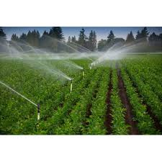
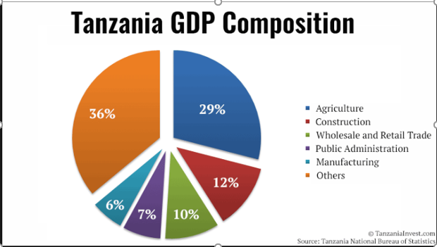
Agriculture Is The backbone of Our Country’s Economy

Slide 3
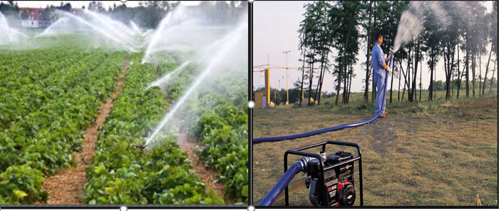
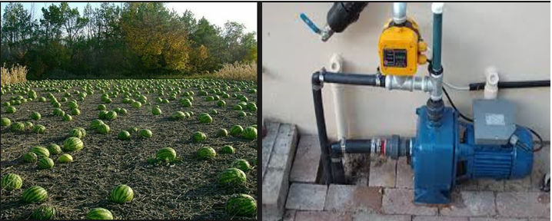
PROBLEM IN PRIVATE IRRIGATION
MANUAL Monitoring Of The Irrigation And Stabilization Of The Farm

Slide 4
solution
KILIMO POA MACHINE
(MONITORING SYSTEM)

Slide 5
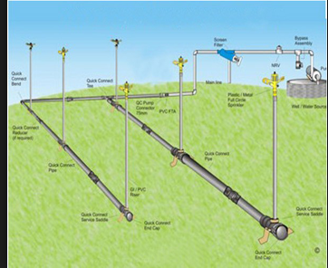
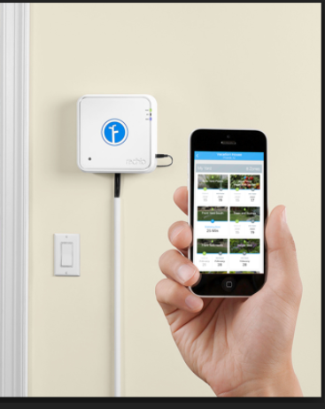
Use your Mobile To take control over the entire farm

Slide 6
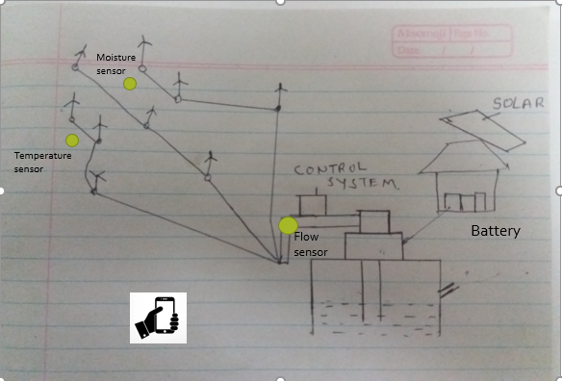
WHAT THE SYSTEM CAN DO
Automatically Monitor the irrigation process using the phone
Easy way to stabilize your farm as the system will provide necessary info
The control System will be as shown here.

Slide 7
84% of the people with private irrigation farms
Market size for our system

Slide 8
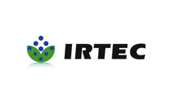

COMPETITORS

Slide 9

Our Advantage
We Are Using SMART Technology
The android app will be as shown here.

Slide 10

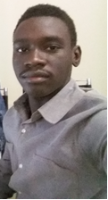

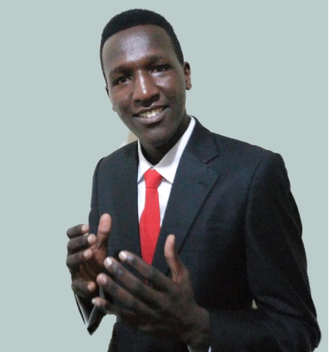
GASPER NYAKI LOOMONI MORWO ALICE KIMARO SAIMON MACHERA ANDROID DEVELOPER DEVELOPER & CO-ORDINATOR ANDROID DEVELOPER DEVELOPER(HARD- WARE)
THANKS TO MY TEAM!

Slide 11
THANK YOU!

